Slide 1
CHAPTER ONE
INTRODUCTION

Slide 2
Overview of SAD
Definition:- System Analysis and Design
is a step by step complex method where by computer based information systems that can perform basic business function are developed and maintained.
It is a standard/techniques set of activities, methods, best practices, deliverables, and automated tools that stakeholders use to analyze, develop and maintain information systems.
It is a process of undertaking a system study using systems approach to solve organizational information system problems.
It is used to analyze, design and implement improvements in the functioning of businesses that can be accomplished through the use of computerized information systems.
The emphasis of system analysis and design is based on business improvement.

Slide 3
Why System Analysis and Design?
From time to time, organizations need to change information systems.
The reasons may be new marketing opportunities, changes in government regulations, and introduction of new technology, a merger with another company, or other changes.
When this happens, the time is ripe for applying systems analysis and design.
Specifically, the basic reasons of knowing SAD are:
To analyze the business requirements and design computer based information systems that fulfills business requirements
To explain the present job
To improve business productivity
To reduce the risks of a projects failure, by applying the steps in SAD to an application of IT

Slide 4
System Analysis and Design is based on two skills (knowledge):
Understanding of organizations objectives, structure and process (domain Knowledge)
Knowledge of how to exploit information technology (IT) for advantage.
What is the outcome of System Analysis and Design?
Application software (information systems) to improve business efficiency
From the definition it is easy to understand that ‘System’, specifically ‘information system’ is a core concept.

Slide 5
System
A system is an interrelated set of components with an identifiable boundary, working together to achieve a common goal.
Examples
Solar system
Digestive systems
Public transport system
Central heating system
Computer system
Information system
A System is set of objects and relationships among the objects viewed as a whole and designed to achieve a purpose
System Elements
INPUT
PROCESS
OUTPUT
FEEDBACK

Slide 6
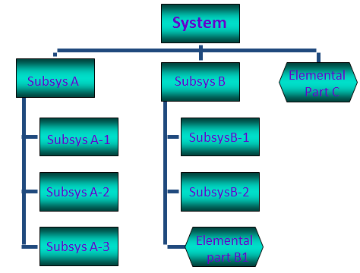
Subsystem
A subsystem is simply a system within a system.
Automobile is a system composed of subsystems:
Engine system
Body system
Frame system
Each of these subsystem is composed of sub-sub --systems.
Engine system: carburetor system, generator system, fuel system, and so son

Slide 7
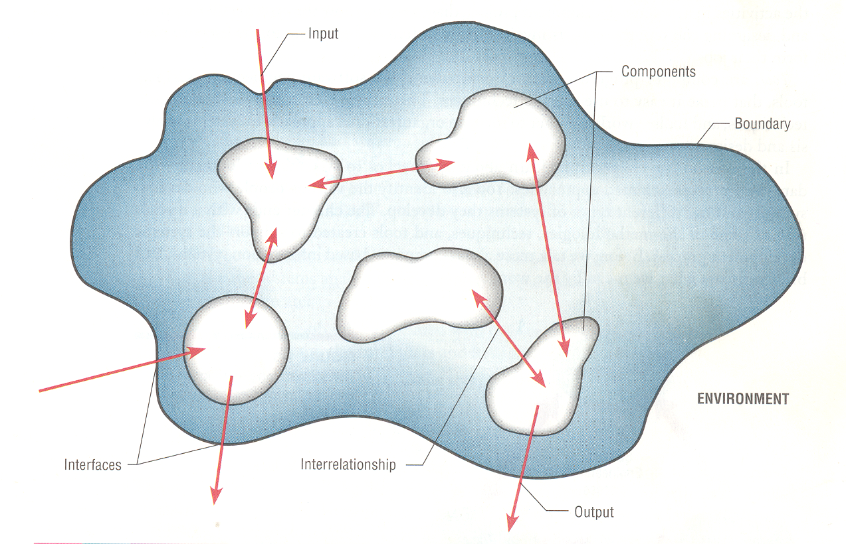
Characteristics of a system
Components - either an irreducible part or an aggregate of parts or subsystem

Slide 8
Components- within the boundary can’t be changed or pats or subsystem.
Interrelated Components – refers to the function of one is tied to the function of the other
Boundary –refers to the limits of the system with in which the system is contained, and that separates it from other systems.
Purpose- The components work together to achieve some overall purpose: the system’s reason for existence
Environment- Everything outside the system’s boundary
Interfaces - the point at which the system meets its environment
Input-What the system takes in from the environment to function
Output- The result of the function of the system
Constraints- limits to the system in terms of its capacity

Slide 9
Example : desktop computer system
Components: Hard disk, CPU, screen, keyboard
interrelated components: CPU-Hard disk
Boundary: case, table
Purpose: perform tasks accurately
Environment: Classroom
Interface: the computer is inside the classroom
Inputs: data
Output: the process data displayed using the output device and the information we gate
Constraints: loss of data, loss of power, storage capacity

Slide 10
Other Important System Concepts
Decomposition - being able to break down a system into its components.
It also helps to build different parts of the system at different times or by different individuals.
Hierarchical decomposition is the process of decomposing a system in a top-down fashion.
First the system is divided into subsystems, then into functions, and then modules.
2. Modularity - relatively uniform size components or chunks.
3. Coupling - the extent to which subsystems are dependent on each other.
As much as possible the subsystems should not be very much coupled.
4. Cohesion- the extent to which a module or a subsystem performs a single function.

Slide 11
When we have highly cohesive modules each module accomplishes one and only one function.
This makes the module reusable in future programs.
Systems Thinking
It is a mind set or way of viewing a world as a system.
Actually, system thinking is just one part of the skills a systems analyst requires.
It helps to see the big picture
It also pays to break problems down to their components to avoid complexity.
Minimize the effect a change in one module will have on another.
Take a lap top as an example.
It emphasize on the relationship and the process that go inside rather than constituent part or just the sum of the parts.
Accordingly “A system is bigger than the sum of its components”

Slide 12
Assignment 1
Identify something as a system (you should already have done this in the classroom in the group discussion).
Identify and describe its characteristics ( the 9 characteristics discussed in class)
Assignment 2
1. Describe, explain and indicate the differences between them for the following system terminologies and prepare a short note for it and submit to your instructor
Living Vs Non-living systems
Open Vs. Closed systems

Slide 13
Information System(IS)
Information System is an organized combination of people, hardware, software, communication networks, and data resources that collects, transforms and disseminate information in an organization to:
Support and improve day-to-day operations of the organization
As well as support the problem solving and decision making needs of management and users.
Data
Data-are raw facts or observations, typically about physical phenomenon or business transactions.
More specifically, data are objective measurements of the attributes or characteristics of entities(such as people, places, things and events).
Names, quantities and Birr amounts recorded on sales forms represent data about sales transactions.

Slide 14
Information
Information is defined as data that have been converted in to a meaningful and useful context for specific end users.
Information to be valuable or useful, it should fulfill some attributes or characteristics which can be expressed in terms of three dimensions of time, contents and form.
Content dimensions include:
Accuracy, Relevance, and Completeness
2. Form Dimensions include:
Clarity, details, order, presentation and media
3. Time Dimension: information to be useful should satisfy the following characteristics:
Timeliness, currency, frequency and time period
End Users- are people who use an information system or the information it produces.

Slide 15
They can be accountants, sales person, engineers, clerks, customers or managers.
It includes any one who uses an information system or the information except few people who are known as information system specialists( system analysts, programmers and computer engineers and etc.)
Information Technology(IT)- is a contemporary term that describes the combination of computer technology (hardware and software) with telecommunications technology(data, image, and voice networks).
This course, for the most part, is about “analyzing” business requirements for information systems and “designing” computer based information systems that fulfill business requirements

Slide 16
Types of Information Systems
IS can be classified in to various types based on the part of the business that they support and on the basis of the function of the IS.
Therefore, understanding the various classes helps the analyst to choose between various technologies or kinds of systems to solve a specific business problem.
I) Classification of IS based on the part of the business that they support
1. Front-Office Information Systems
Support business functions that reaches out to the customers
Typically describes all of the functions that involve customer interaction.
For example:- In a retail scenario, front office functions might include sales transactions, informational resources, and all customer service activities.

Slide 17
2. Back-office Information Systems
Support internal business operation of an organization
It is comprised of the areas that don’t directly generate revenue for the business, but provide vital support and administration.
The back office in an investment bank might encompass departments like IT, operations, Human Resource, Accounting and Compliance.
They perform functions that mostly focus on processing or support.
II) Classification of IS based on the basis of the function of IS:
1.Transaction Processing Systems (TPS)
is a computer based information system that handle data about business activities or transactions, to be simple, and discrete events in the life of an organization.

Slide 18
The goal of TPS development is to improve transaction processing by speeding it up, using fewer people, improving efficiency and accuracy, integrating it with other organizational information systems, or providing information not previously available.
Transaction Processing System(TPS) has the following features(distinctive part):
The inputs and outputs of TPS are business transaction data such as bills, orders, inventory levels, and the output consist of process transactions like bills, paychecks and payroll.
It is designed for fewer managers:
Because the TPS deals with day-to-day matters(activities), it is particularly of use to supervisory managers.
In other words, TPS helps in making operational decision.
Such systems are not useful to middle or top managers

Slide 19
iii) It produces detail reports:
Managers at this level typically will receive information in the form of detail reports containing specific information about routine activities.
iv) One TPS is developed for each function:
Each department or functional area of an organization usually has its own TPS.
Example marketing TPS handles sales order.
v) It is basis for MIS and DSS:
The database of transactions stored in a TPS based to support management information system, decision support system and other advanced systems that provides information to top level managers.
Typical example transaction process system include:
Bank deposits and withdrawals,
Course registration in college,
Payroll,
Order processing and etc.

Slide 20
2. Management Information Systems (MIS)
is a CBIS that uses data recorded by TPS as input into programs that produce routine reports as outputs.
This system is designed to serve middle level managers and support activities such as planning, controlling and administrative activities.
They produce predetermined reports such as trend analysis, summary data, or exception reporting.
Examples:
AIS,
Budget Analysis and Forecasting,
Sales Reporting and Forecasting and etc.

Slide 21
3. Decision Support Systems(DSS)
It is a system designed based on the TPS and MIS of an organization.
It is a CBIS that provide management an interactive environment in which decision makers can quickly manipulate data and models of business operations.
The system produces flexible, on-demand reports which a top managers can make decisions about unstructured or complex problems.
DSS is designed mainly for top managers and it uses mathematical models
In addition to what MIS have DSS allow interaction with the user to help the user make what if analysis using data and models.
For instance, what is the impact of increasing our price by 10% on net profit?

Slide 22
4. Expert Systems
The concept of expert systems originated from research in the field of artificial intelligence (AI).
Artificial intelligence is the subfield of computer science that attempts to develop machines that are capable of emulating human thought processes.
It is a branch of computer science that has the goal of understanding intelligence by building computer programs that exhibit intelligent behavior.
It is concerned with the concepts and methods of symbolic inference, or reasoning, by a computer, and how the knowledge used to make those inferences will be represented inside the machine.
AI is also concerned with robotics and natural language processing.

Slide 23
An expert system is a set of interactive computer programs that help users to solve problems that would otherwise require the assistance of a human expert.
Expert systems are created on the basis of knowledge collected from human experts, and they imitate the reasoning process's of a human being.
Expert systems are used both by managers and non-managers to solve specific problems.
It addresses the critical need to duplicate the experienced problem solvers, managers, professionals, and technicians.
Expert system imitates the logic and reasoning of the experts within their respective fields.

Slide 24
5. Office Automation Systems
It is a system designed to reduce the manual labor required to operate an efficient office administration.
Office automation supports range of office activities that provide for improved workflow and communications between workers.
Examples:
Word Processing
Spreadsheet
Microsoft Outlook
NetMeeting

Slide 25
Note
The difference between DSS and ES:
DSS do not make the decisions for management while ES do.
Another difference is in the database:
While the data in DSS is derived from various sources such as TPS and MIS
But the data for ES comes from the knowledge base of the ES which is acquired from experts.
Example can be a credit request evaluation expert system.
Building blocks of IS
Data- the raw material used to create useful information
Processes- the activities that carry out the mission of the business
Interfaces- how the system interfaces with its users and other information systems.

Slide 26
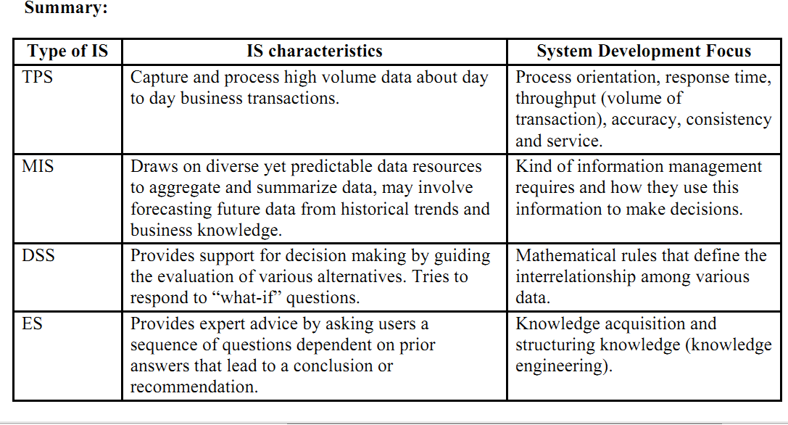

Slide 27
Project 1
1. List the currently available information systems in your organization and discuss to which type these IS correspond and why they think so.

Slide 28
Information System Development
is a process of undertaking a system study using system approach to solve organizational information system problems.
The system approaches is a scientific approach which involves:
Recognizing the phenomena in the real world.
Formulating a hypothesis about the cause and effects of the phenomena
Testing the hypothesis through experimentation
Evaluating the result of the experiment
Drawing conclusion about the hypothesis and etc.
The broad availability of software and the range of consulting services caused IS departments:
To change their focus from being a shop to develop software applications to a shop in charge of implementing the proper information technology architecture.

Slide 29
Today the major responsibilities of the typical IS department are:
Developing an IT plan to support the strategic objectives of the business.
Developing, operating, and maintaining existing inter-enterprise IS and database
Installing and maintaining local and wide area networks
Evaluating, acquiring, and integrating new hardware and software products.
Training and supporting internal end-users
Negotiating with and overseeing outside IS consultants in the acquisition and development of new information technology and systems.

Slide 30
Dimensions of Information System
Information System has three dimensions:
Scope of the Information System( ranging from individual to inter organizational)
Complexity of the task being supported( ranging from well-structured to unstructured)
The necessary information richness to provide the required support
Organizations develop a long term strategy for the development of information system for the following reasons:
Firms spend considerable amount of capital or budget on information system and information technology.
To pursue the strategic opportunities of companies using information system
IS and IT support all operations and functions to provide reliable and efficient services of most medium and large scale organizations and modern business operations

Slide 31
Principles of System Development
Basic Principles of System Development includes:
The system is for end users
Establish phase and tasks
System development is not a sequential process
Justify System as capital investments
Do not be afraid to revise or cancel scope
Documentations is the products of all phases
Use a problem-solving approach
Design system for growth and change
Divide and Conquer a system
In addition to the above principles, a system should be:
Designed to provide information at reasonable cost

Slide 32
Designed to permit effective reports, which are the primary system products
Designed to be compatible with available human factors in terms of skills and knowledge
Take into account the specific structure of the organization. Because the system function is specific and clearly defined organizational setting.
Reliable and accurate so that it can safeguard assets, minimize errors and prevent fraud and other irregularities.
Flexible, yet ensure reasonable uniformity and consistency of applications in order to facilitate the dynamics of business.

Slide 33
Stakeholders in System Development
Normally system development is team work and project based.
Who do you think are the stakeholders (participates) in IS design and development?
How does each of these stakeholders participate?
System Owners
is the one who pay for the system to be built and maintained.
They own the system, set priorities for the system, and determine policies for its use.
In some cases, system owners may also be system users.
2. System Users
are the people who actually use the system to perform or support the work to be completed.
System users define the business requirements and performance expectations for the system to be built.

Slide 34
3. System Analysts
Facilitate the development of information systems and computer applications by bridging the communications gap that exists between non-technical system owners and users and technical system designers and builders.
4. System Designers
are the technical specialists who design the system to meet users’ requirements.
In many cases, system designers may also be system builders.
5. System Builders
are the technical specialists who construct, test, and deliver the system into operation.
6. IT vendors and consultants
are those who sell hardware, software and services to businesses for incorporation into their information systems.

Slide 35
Information System Architecture
Provides a framework to understand information systems and combines the above stakeholders and building blocks to arrive at a unified view of the information system construction process.
The following framework presented on next slide is John Zachman’s popular information systems architecture.
It combines the stakeholders and building blocks of IS to describe the information systems analysis and design process.

Slide 36
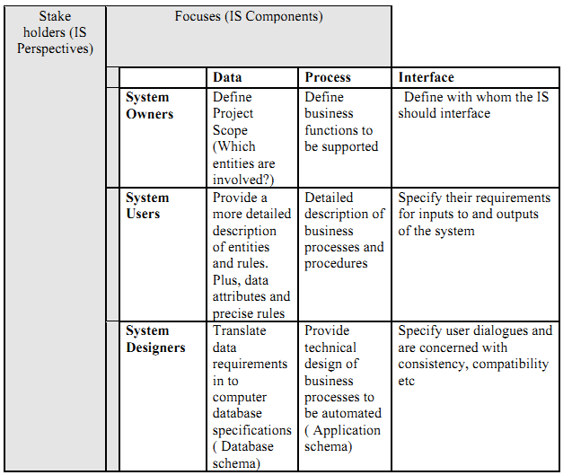

Slide 37
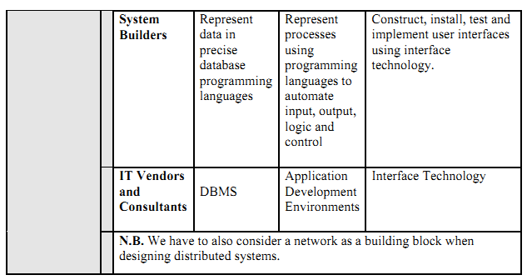

Slide 38
Where is a system analyst in all this?
He is everywhere. He is the core team member.
Necessary skills required from a given system analyst are presented as follows:
1. Analytical skills
a. Systems thinking (already covered)
b. Organizational knowledge- how organizations work
Example a payroll system developed for a Government Unit wouldn’t work for a private company- tax computation logic, terminology and computational logic difference in social security funds.
Inbound logistics, operations, outbound logistics, marketing and sales, service, and support activities such as infrastructure, technology, human resource and purchasing.
c. Problem Identification-a problem is the difference between an existing situation and a desired situation.
Being able to see the real problem from an organizational perspective, identify a problem starting from now for your project.

Slide 39
Problem analyzing and solving- finding out more about the problem, formulating alterative solutions, choosing the best alternative, devising a plan for its implementation.
Reminds you of the SDLC.
2. Technical skills- programming languages, operating systems, database systems, data communication systems, system development tools, web development languages, CASE tools
3. Management skills
Resource management- delegating work, use other resources effectively and efficiently
Project management- prevent projects from coming in late or going over budget
Risk Management- identifying risk in an IS development process and minimizing it. For instance, use of standard or commonly used technology will be less risky than otherwise.
Change management- helps people make a smooth transition from one information system to another.

Slide 40
4. Interpersonal skills
Communication skills- interviewing, listening and questionnaires, written and oral presentations; require you to communicate with users, management or information systems professionals.
Working alone and with a team,
Facilitating groups-guiding groups to work together
Managing expectations- educate pessimists and temper the expectations of others.

Slide 41
System Development Approaches &Methodologies
Tasks in system analysis and design require use of standard and prescribed process.
If IS development projects follow no prescribed process, we will have a situation of anarchy or chaos.
Each developer uses his/her own tools and methods
Communication between team members would be difficult
Success or failure depends on the skill and experience of the project team
The process will be unpredictable and not repeatable
The project may become over budget and behind schedule as a result of the above

Slide 42
Documentation will be haphazard creating problems for maintenance.
Insufficient user involvement alone may lead to dissatisfaction at the end.
A standard systems analysis and design methodology thus results in better productivity by alleviating the above problems.
Accordingly the following discussion shows six standard phases in a system development which collectively referred as SDLC

Slide 43
Phases in the SDLC
1. Project Identification and Selection:
This is the first stage where the need for a new or enhanced system is identified.
This need may arise as a result of
Problems faced by users in day to day operations or their desire to perform additional tasks (by end users)
To capitalize an opportunity as a result of the organization’s strategic planning process (by system analysts)
A need for efficiency and effectiveness (by the management)
Once potential system development projects have been identified, they have to be classified and ranked.

Slide 44
IS projects can be ranked based on:
Value chain analysis
Strategic alignment
Potential benefits
Availability of resources
Project duration or size
Technical difficulty or risks
The final step in project identification and selection involves choosing some IS projects among the ones ranked as above.
Those projects perceived most likely to achieve business objectives are selected.
2. Project Initiation and Planning
This phase involves:
A preliminary investigation of the system problem or opportunity at hand.

Slide 45
And the presentation of reasons why the system should or should not be developed by the organization.
This phase specifically involves such tasks as:
Assessing feasibility of the IS development project
Listing the activities involved in the project
Preparing a (time) schedule of the activities (using tools like PERT and Gantt charts
3. Analysis
Analysis involves a thorough study of an organization’s current procedures and the information systems used to perform organizational tasks.
Analysis consists of the following major tasks:
Requirements determination- involves gathering facts about what users actually want through interviews, questionnaires and so forth

Slide 46
Requirements structuring- involves using models or graphical representations of users’ requirements or the current system.
It also involves trying to avoid any redundancies in the current system.
The models used can be Data Flow Diagrams, Data Dictionaries and so forth.
Finally we have to prepare initial design alternatives and choose between them at this stage.
For instance, we have to decide between buying and building in house the application software for the proposed system.

Slide 47
4. Design
Design involves converting the description of the recommended alternative system into logical and then physical design specifications.
This means we have to specify:-
What input forms would look like
What output forms (reports) would look like
What other interfaces and dialogues would look like
The database design
Architectural design of the system
Finally, we have to change all the above in to physical design specifications using either diagrams or prototypes.

Slide 48
5. Implementation
At this stage the physical specification is turned into a working system, the system is tested and then put to use.
This phase specifically involves:
Coding
Testing
Installation
Data conversion (data entry)
Finalizing documentation

Slide 49
6. Maintenance/User support
A system has to be maintained once it has been implemented.
Maintenance requests may arise as a result of:
Faults found in the system by users
Better ways of doing a task using the system or improvements on the system thought out by users
Change in the nature of business functions or environment
Over time it becomes obvious that because of prohibitive nature the costs spent to maintain a system it may be necessary to throw it out and design a new system which takes as back to the project identification and selection phase.

Slide 50
There are also cross life cycle activities such as:
Fact Finding- involves gathering data or feedback about different aspects
Documentation and Presentation- recording facts and specifications for a system for current and future reference and communicating these findings
Feasibility Analysis- measuring how beneficial the development of an IS would be to the organization
Project Management- defining, planning, directing, monitoring and controlling a project to develop an acceptable system within the allotted time and budget.
Change Management- training and convincing users about the change that is going to happen as a result of the IS to be developed

Slide 51
Methodologies in SAD
Methodologies = tools + steps (process) + techniques
1. Structured System Analysis and Design
Structured system analysis and design devotes more time at the analysis and design phases and is a model driven approach to systems analysis and design. It uses:
Such tools as Data Flow Diagrams to model process and Entity Relationship diagrams to model data requirements
Structure Charts at the design phase to model program (process structure)

Slide 52
2. Object Oriented Analysis and Design (OOAD)
This is also a model driven approach to SAD but merges the data and process concerns into singular constructs called objects.
Object oriented analysis and design models a system in terms of its objects and their interactions.
In doing so it uses such diagrams as Use-Case diagrams, object class diagrams and so forth.
This approach uses a standard modeling language known as the Unified Modeling Language (UML).
3. Rapid Applications Development (RAD)
RAD is an approach to developing information systems that promises better and cheaper systems and more rapid deployment by having systems developers and end users work together jointly in real-time to develop systems.

Slide 53
RAD uses a combination of evolutionary prototyping, Joint Application design and CASE tools in order to shorten the time required to build systems.
Approaches to Improving any SAD Methodology
Prototyping
refers to designing and building a miniaturized (scaled-down) but functional version of the proposed system.
In structured system analysis and design prototypes can be used to validate users’ requirements at the analysis and design stages.
In this approach users work with the prototype and tell the analyst what they like and do not like about it.
The analyst then brings the prototype back to users after improving it based on their feedback.

Slide 54
This iterative process continues until users are satisfied with what the prototype does.
Here, you have to differentiate between evolutionary prototypes in RAD and throw away
prototypes used in other methodologies such as structured SAD.
Using prototyping as an analysis and design tool has got the following advantages:
Prototyping involves users to great extent
It captures users’ requirements in concrete terms than abstract or graphical form
2. Joint Application Design
In JAD users, managers and systems developers are brought together for a series of intensive facilitated meetings run by a JAD session leader.
JAD helps to better manage organizational resources and time by gathering the stakeholders in an IS project in one room at the same time to work together to agree on system requirements.

